Slide 1
Objectives
Explore the history and theory of CSS
Define a style rule
Study style precedence and inheritance
Apply color using CSS
Explore CSS3 color extensions
Use contextual selectors

Slide 2
Objectives
Work with attribute selectors
Apply text and font styles
Install a Web font
Define list styles
Use pseudo-classes and pseudo-elements
Create a rollover effect

Slide 3
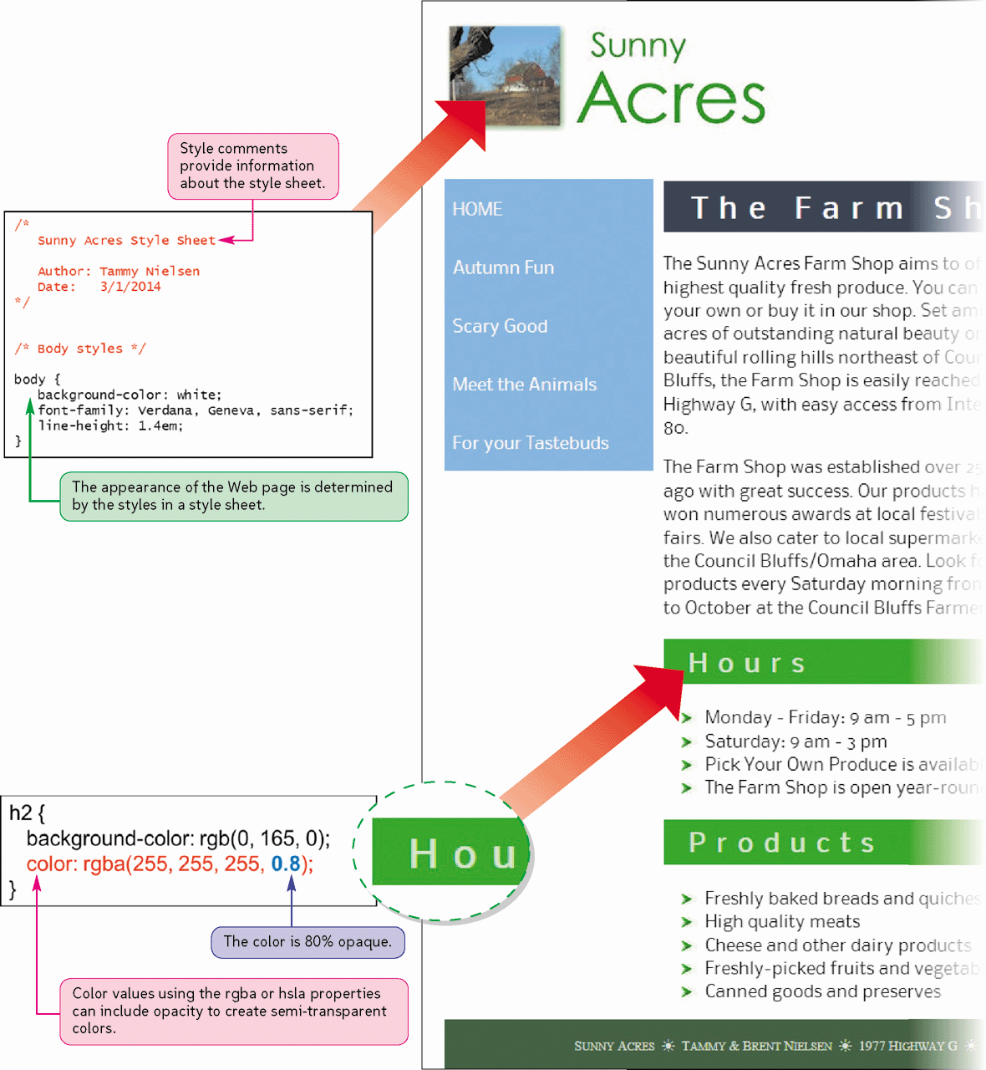
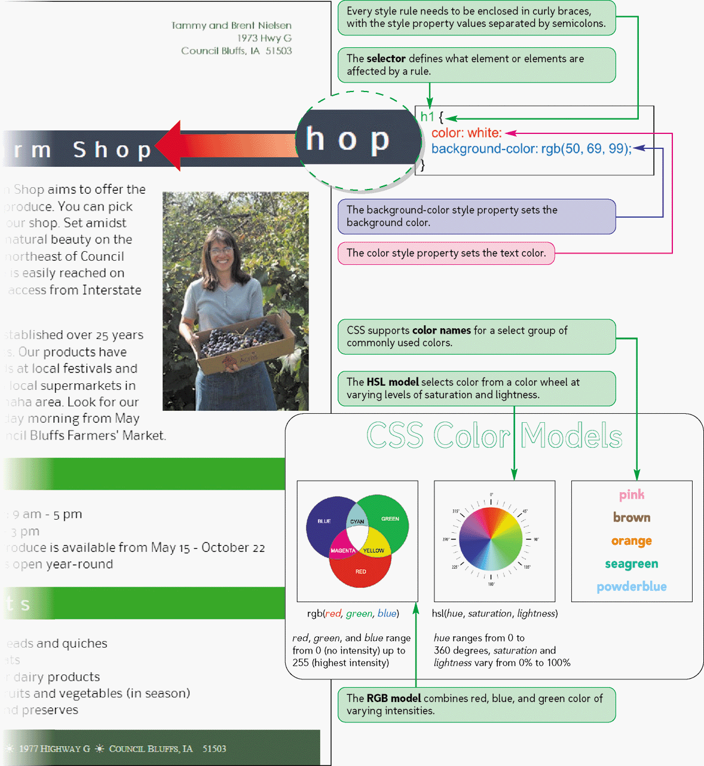
Style Sheets and Color

Slide 4
Introducing CSS
To render a document, the device displaying the page needs a style sheet that specifies the appearance of each page element
The style sheet language used on the Web is the Cascading Style Sheets language, also known as CSS
Versions include CSS1, CSS2, CSS 2.1, and CSS3
With CSS, as with HTML, Web page designers need to be aware of compatibility issues that arise not just among different versions of the language, but also among different versions of the same browser

Slide 5
Defining a Style Rule
The general syntax of a CSS style rule is
selector {
property1: value1;
property2: value2;
property3: value3;
...
}

Slide 6
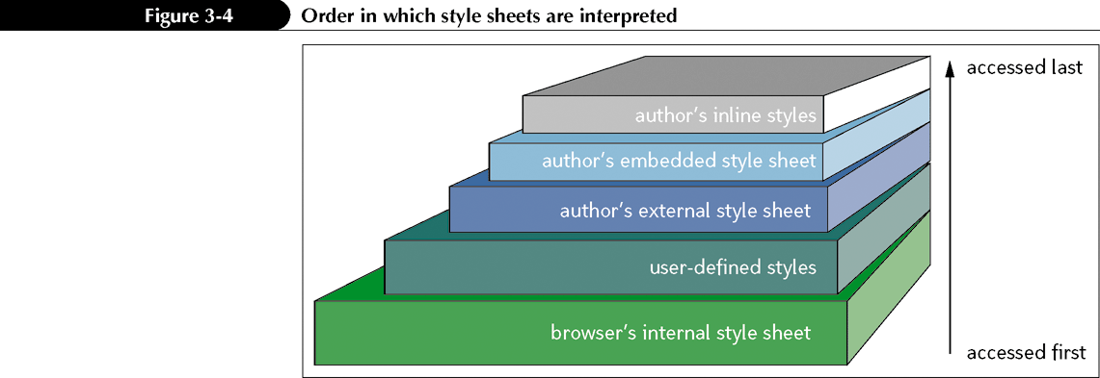
Applying a Style Sheet
The design you apply to a Web site is usually a combination of several style sheets

Slide 7
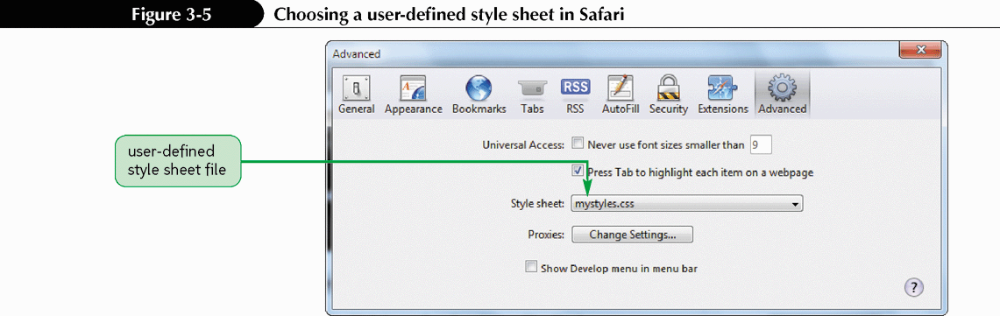
User-Defined Styles
Almost all browsers allow users to modify the default settings of the internal style sheet

Slide 8
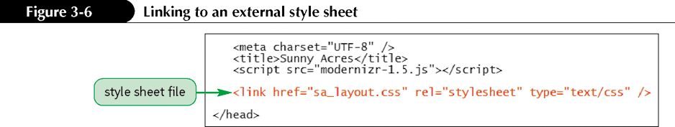
External Style Sheets

Slide 9
Embedded Style Sheets
Another type of style sheet created by a Web page author is an embedded style sheet, in which the styles are inserted directly within the head element of an HTML document using the style element
<style type=”text/css”>
styles
</style>
The exact order in which external style sheets and embedded style sheets are processed by the browser depends on the order in which they are listed within the HTML file

Slide 10
Inline Styles
The very last styles to be interpreted by the browser are inline styles, which are styles applied directly to specific elements using the style attribute
<element style=”style rules”> … </element>
It is clear exactly what page element is being formatted
Not recommended in most cases and considered inefficient

Slide 11
Exploring the Style Cascade
As a general rule of thumb, all other things being equal, the more specific style is applied instead of the more general
An additional factor in applying a style sheet is that properties are passed from a parent element to its children in a process known as style inheritance
body {color: blue;}
h1 {text-align: center;}

Slide 12
Exploring the Style Cascade
If you need browsers to enforce a style, you can append the !important keyword to the style property, using the syntax
property: value !important;
The !important keyword is often necessary for visually impaired users who require their pages rendered with large, clear text and highly contrasting colors

Slide 13

Writing Style Comments

Slide 14
Defining Color in CSS
A color value is a numerical expression that describes the properties of a color
CSS represents these intensities mathematically as a set of numbers called an RGB triplet, which has the format
rgb(red, green, blue)
CSS also allows RGB values to be entered as hexadecimal numbers
#redgreenblue

Slide 15
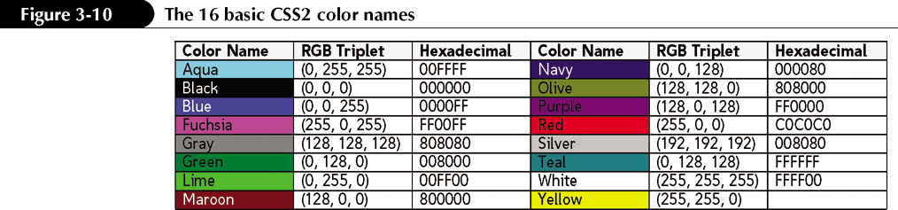
Defining Color in CSS

Slide 16
Setting Foreground and Background Color
To set the background color of an element, use the property
background-color: color;
where color is a color name or a color value.
To set the foreground or text color of an element, use the following property:
color: color;

Slide 17
Enhancements to Color in CSS3
CSS3 also supports the Hue Saturation Lightness (HSL) model that describes colors based on hue, saturation, and lightness
hsl(hue, saturation, lightness)

Slide 18
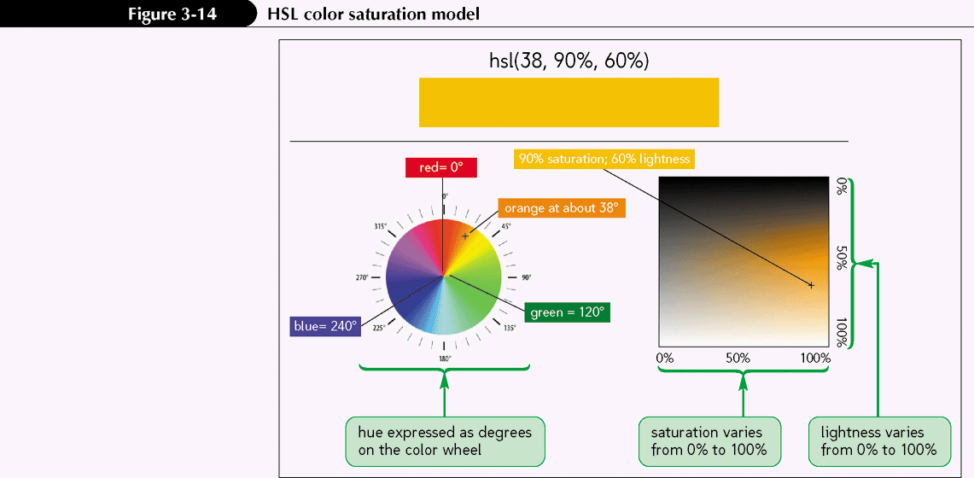
Enhancements to Color in CSS3

Slide 19
Enhancements to Color in CSS3
CSS3 also allows page designers to augment RGB and HSL color values by specifying a color’s opacity. Opacity defines how much of the colors below the surface of the current object show through to affect its appearance
rgba(red, green, blue, opacity)
hsla(hue, saturation, lightness, opacity)

Slide 20

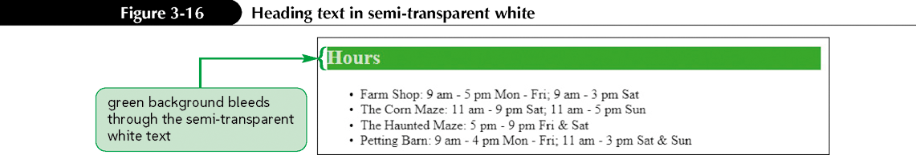
Enhancements to Color in CSS3

Slide 21
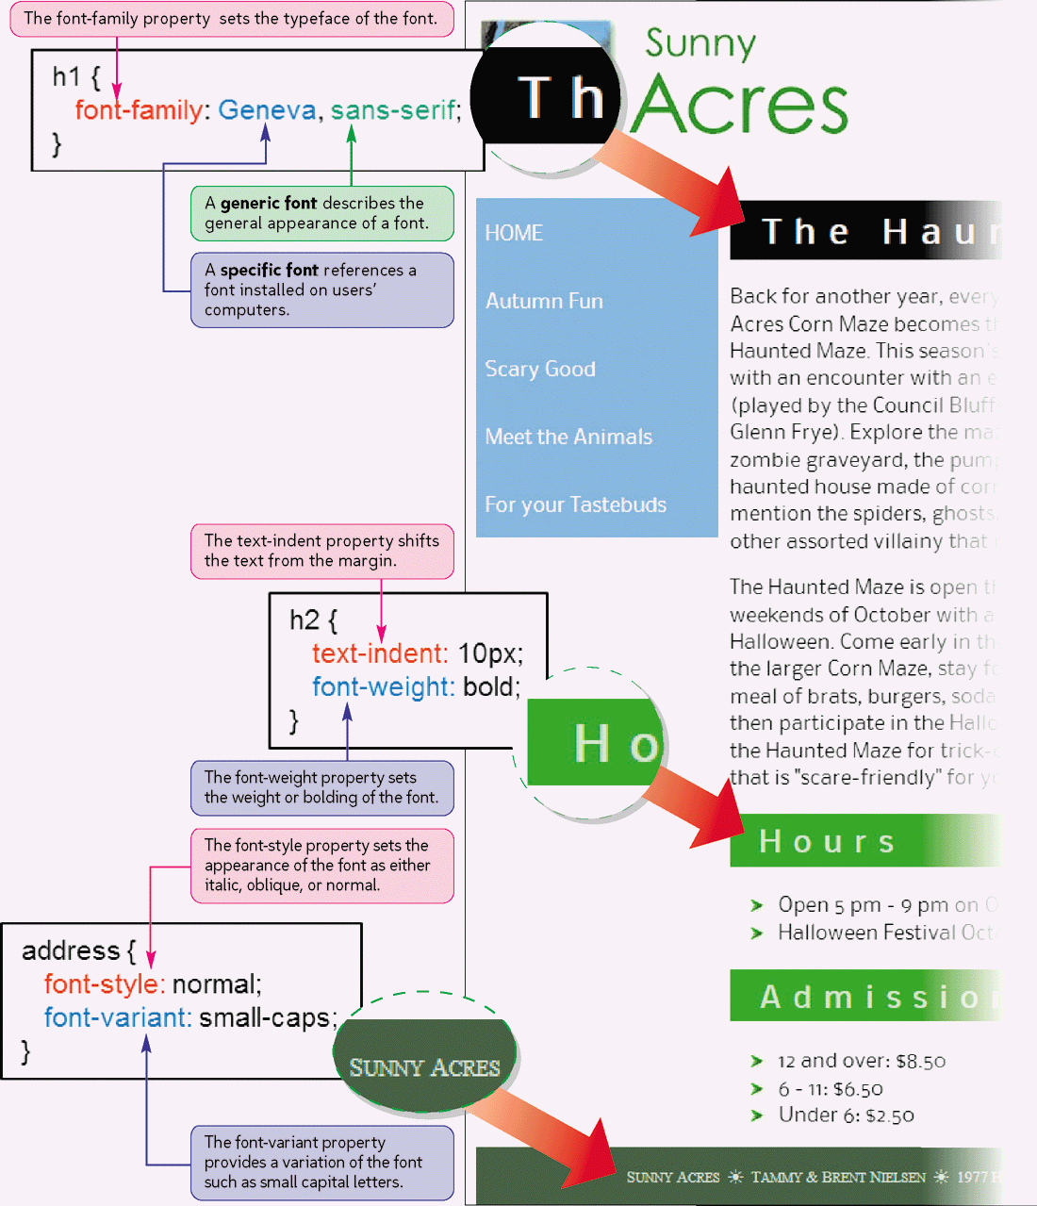
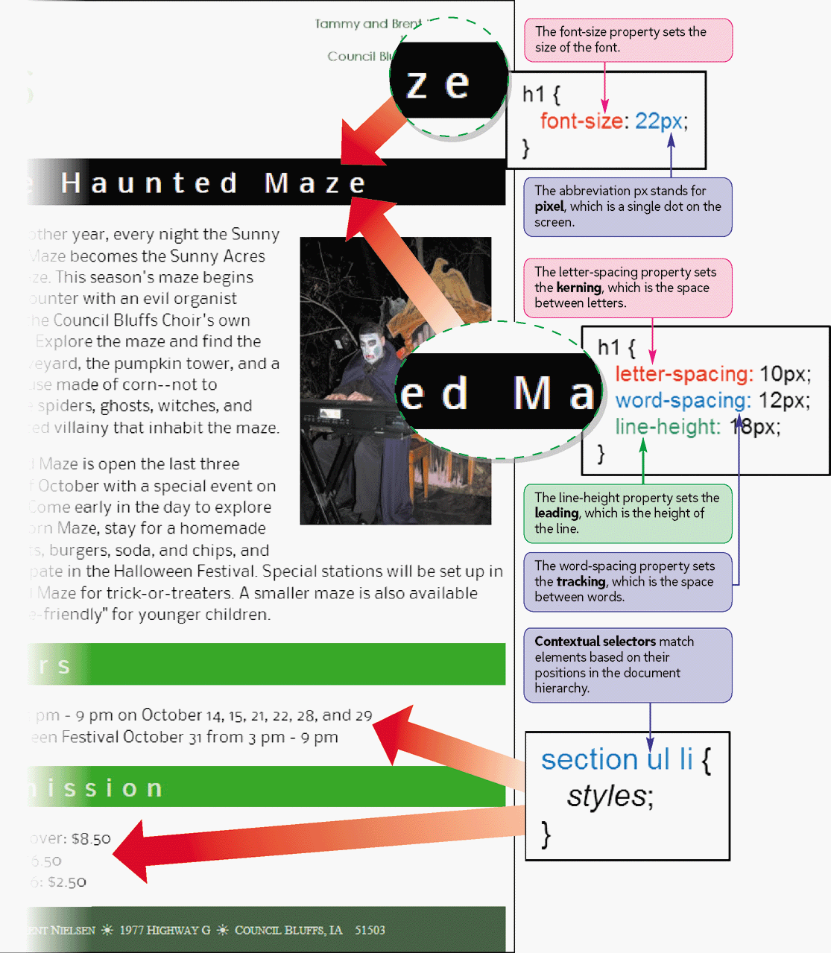
Selectors and Text Styles

Slide 22
Contextual Selectors
Web pages are structured documents in which elements are nested within other elements, forming a hierarchy of elements
To create styles that take advantage of this tree structure, CSS allows you to create contextual selectors whose values represent the locations of elements within the hierarchy
Parent elements
Child elements
Sibling elements
Descendant elements

Slide 23
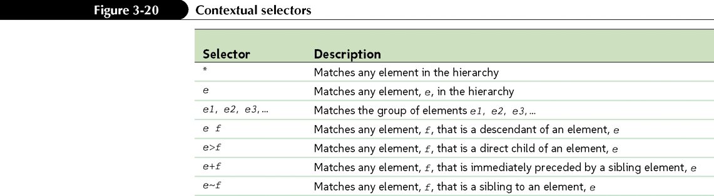

Contextual Selectors

Slide 24
Attribute Selectors
Selectors also can be defined based on attributes and attribute values associated with elements
Two attributes, id and class, are often key in targeting styles to a specific element or group of elements

Slide 25
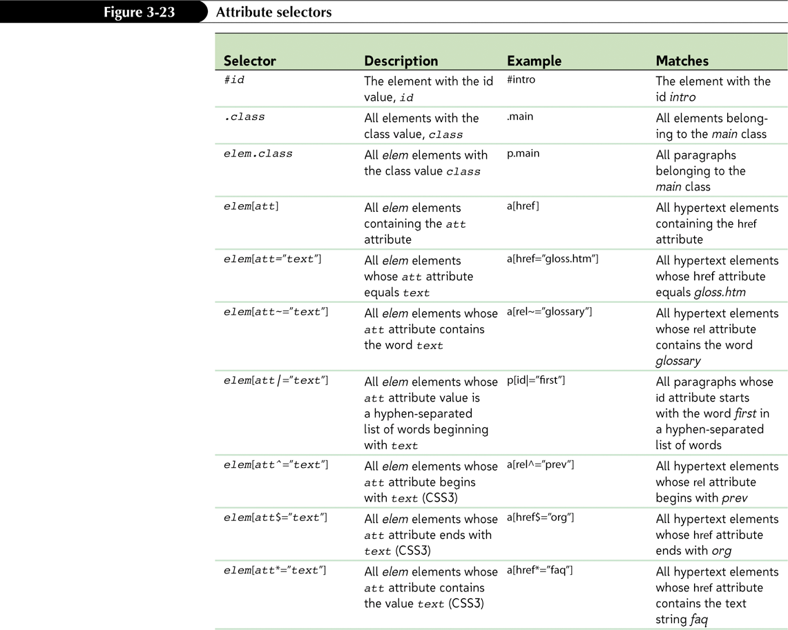
Attribute Selectors

Slide 26
Styling Web Page Text
The default font used by most browsers is Times New Roman, but you can specify a different font for any page element using the property
font-family: fonts;
fonts is a comma-separated list of specific or generic font names

Slide 27
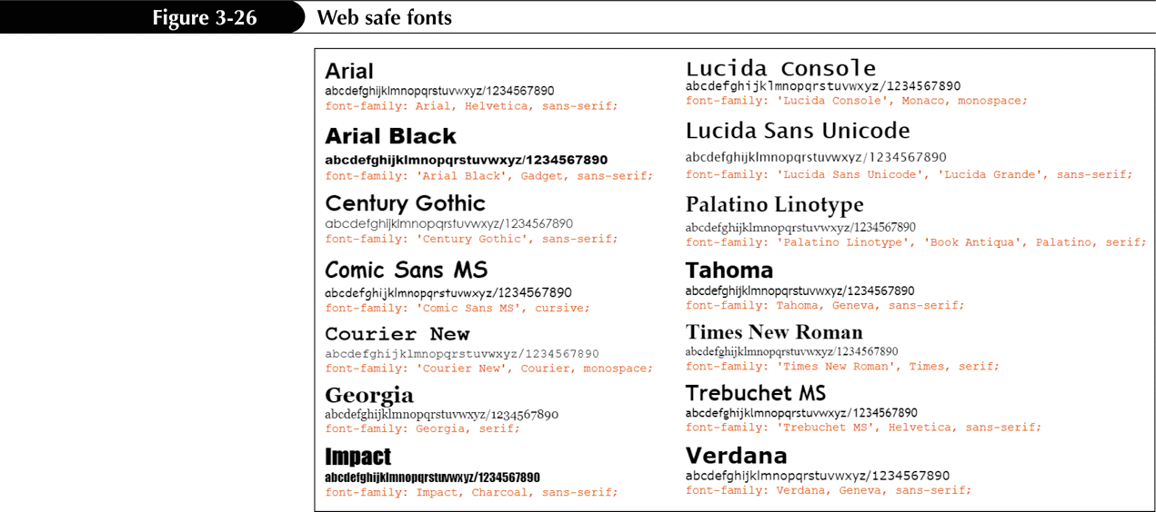
Styling Web Page Text

Slide 28
Setting Font Face and Sizes
To define a font face, use the style property
font-family: fonts;
where fonts is a comma-separated list of fonts that the browser can use with the element. List specific fonts first and complete the list with a generic font.
To set a font size, use the style property
font-size: size;
where size is a CSS unit of length in either relative or absolute units.

Slide 29
Setting Font Face and Sizes
To set kerning (the space between letters), use the following style property:
letter-spacing: size;
To set tracking (the space between words), use the following style property:
word-spacing: size;

Slide 30
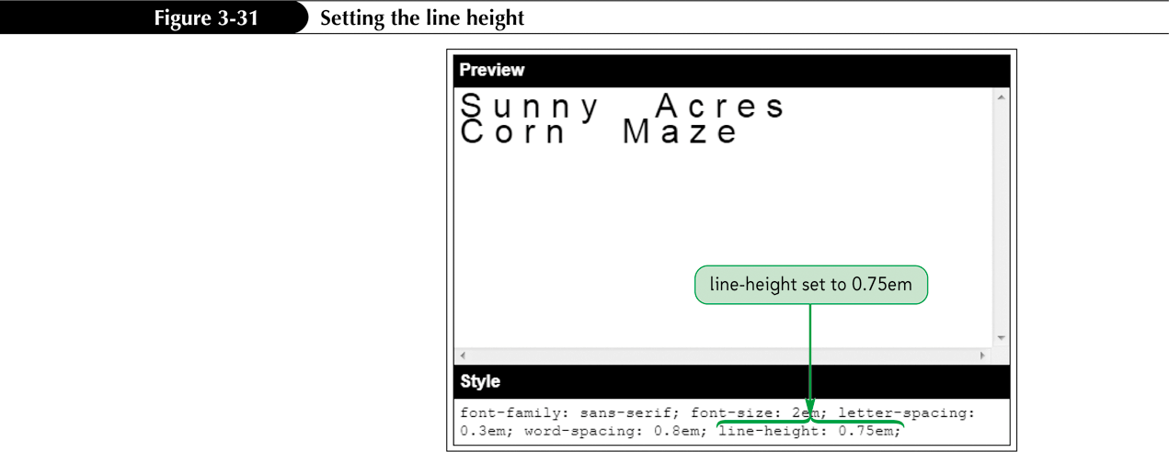
Setting the Line Height

Slide 31
Setting Font and Text Appearance
To specify the font style, use
font-style: type;
where type is normal, italic, or oblique.
To specify the font weight, use
font-weight: type;
where type is normal, bold, bolder, light, lighter, or a font weight value.

Slide 32
Setting Font and Text Appearance
To specify a text decoration, use
text-decoration: type;
where type is none, underline, overline, or line-through.
To transform text, use
text-transform: type;
where type is capitalize, uppercase, lowercase, or none.
To display a font variant of text, use
font-variant: type;
where type is normal or small-caps.

Slide 33
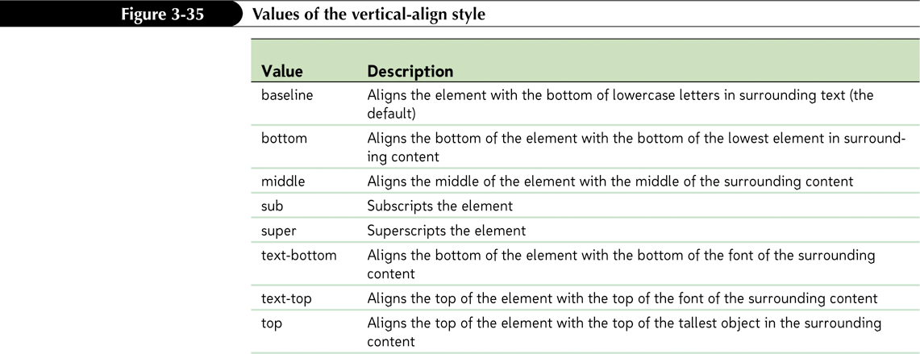
Aligning Text Vertically

Slide 34
Combining All Text Formatting in a Single Style
You can combine most of the text and font styles into a single property using the shortcut font property
font: font-style font-variant font-weight font-size/line-height font-family;

Slide 35
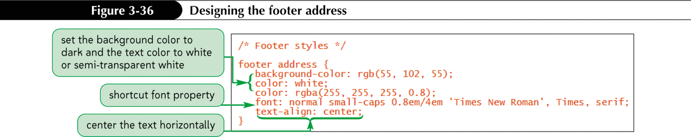
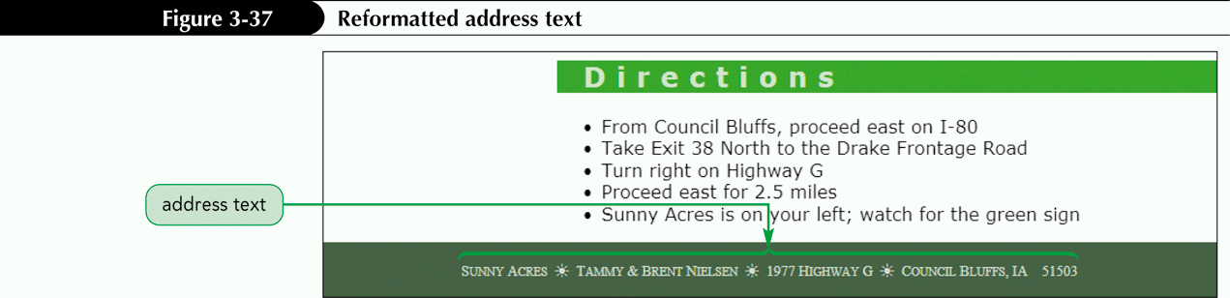
Combining All Text Formatting in a Single Style

Slide 36
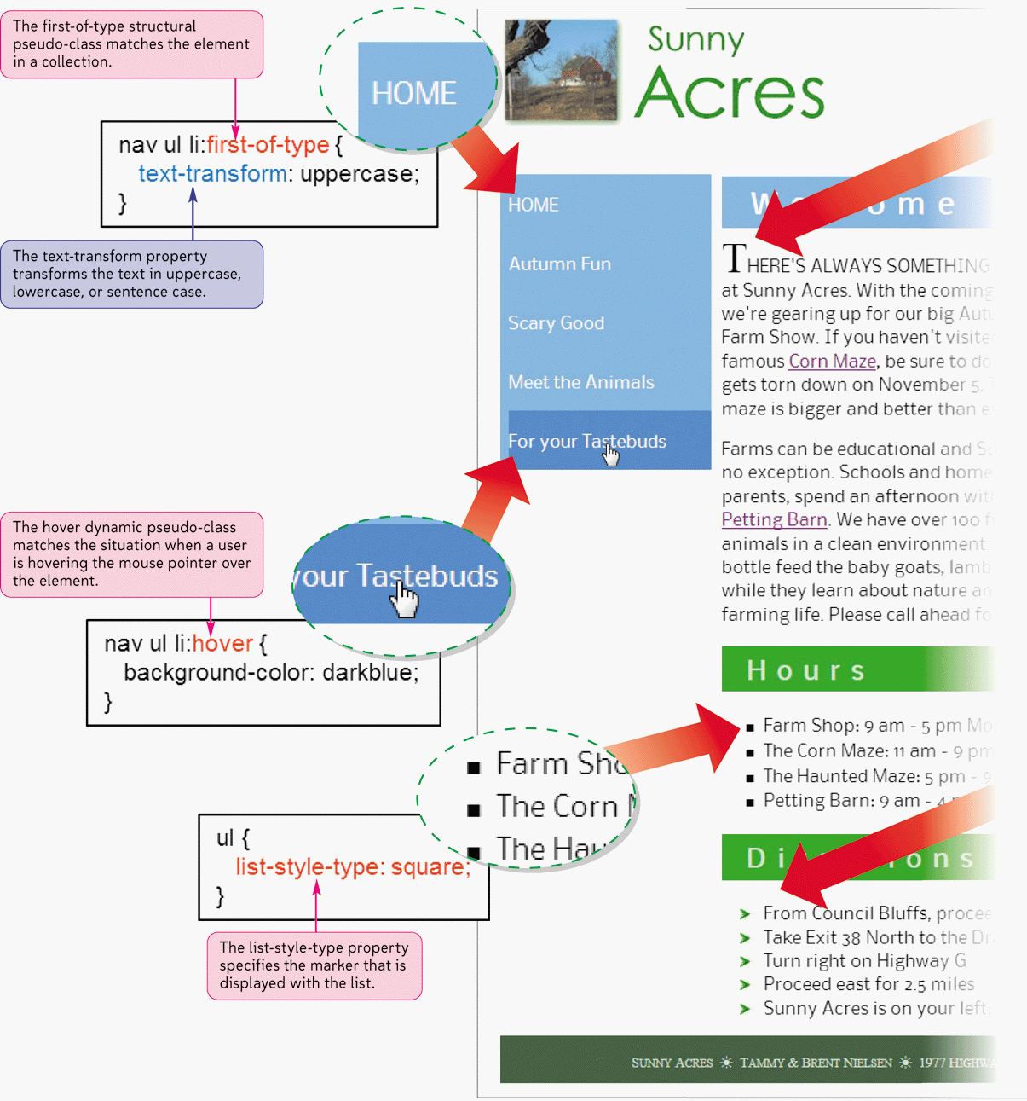
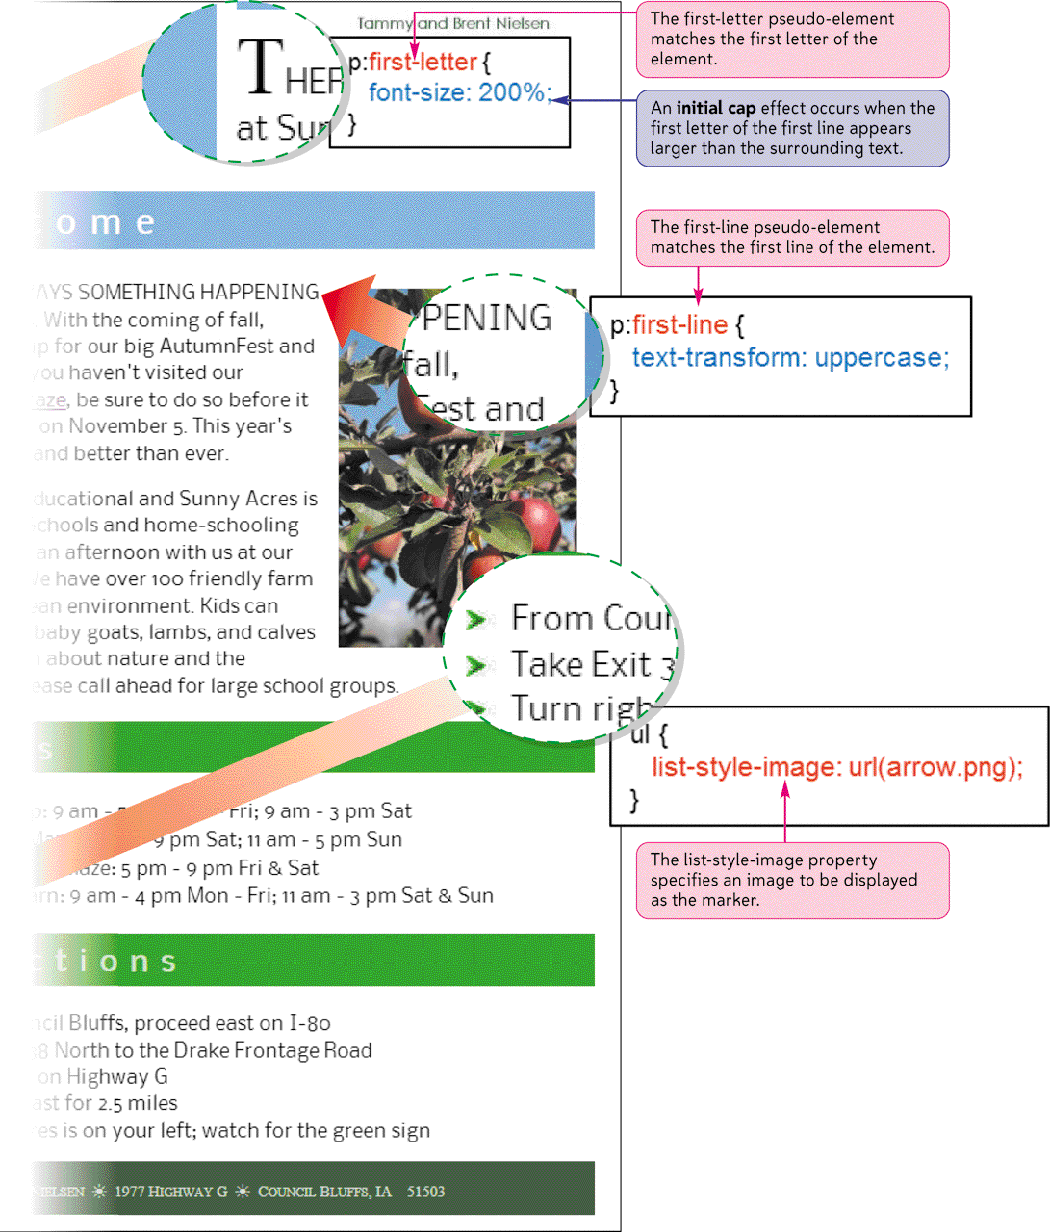
Lists and Pseudo-Items

Slide 37
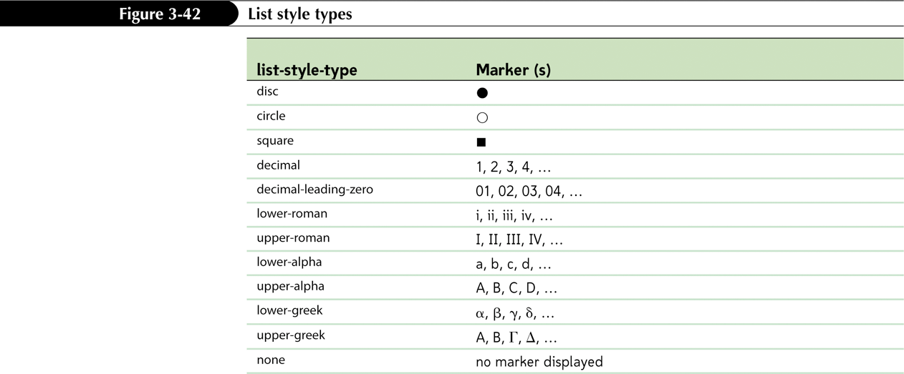
Designing Styles for Lists
To change the marker displayed in ordered or unordered lists, you apply the style
list-style-type: type;

Slide 38
Designing a List
To define the appearance of the list marker, use the style
list-style-type: type;
where type is disc, circle, square, decimal, decimal-leading-zero, lower-roman, upper-roman, lower-alpha, upper-alpha, lower-greek, upper-greek, or none.
To insert a graphic image as a list marker, use the style
list-style-image: url(url);
where url is the URL of the graphic image file.

Slide 39
Designing a List
To set the position of list markers, use the style
list-style-position: position;
where position is inside or outside.
To define all of the list style properties in a single style, use the following style:
list-style: type url(url) position;
To set the indentation of a list, apply the style
padding-left: size;
where size is the length that the list should be indented.

Slide 40
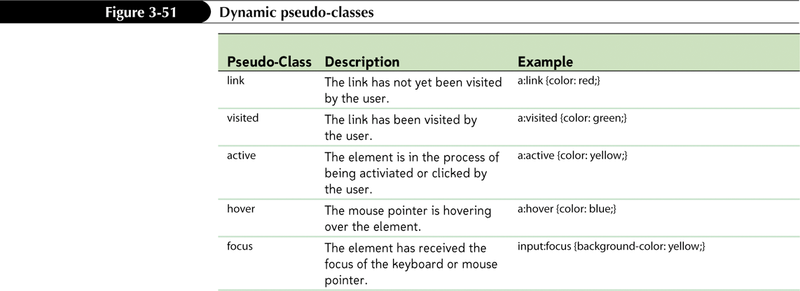
Using Pseudo-Classes and Pseudo-Elements
A pseudo-class is a classification of an element based on its current status, position, or use in the document
selector:pseudo-class {styles;}

Slide 41
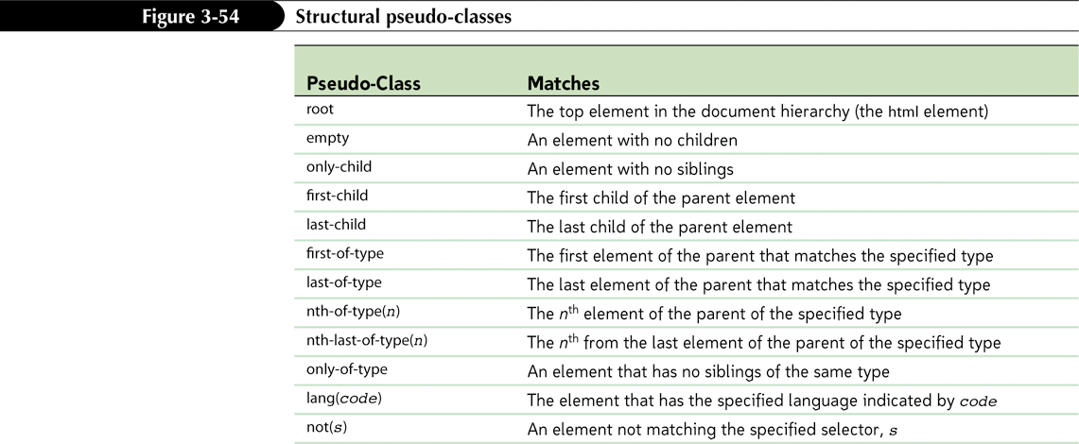
Using Pseudo-Classes and Pseudo-Elements

Slide 42
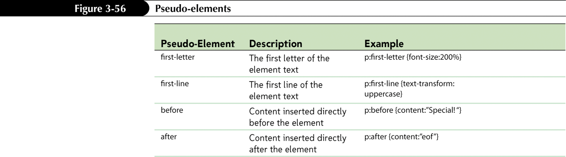
Pseudo-Elements

